Slide 1
Unit-V
Trees and Graphs

Slide 2
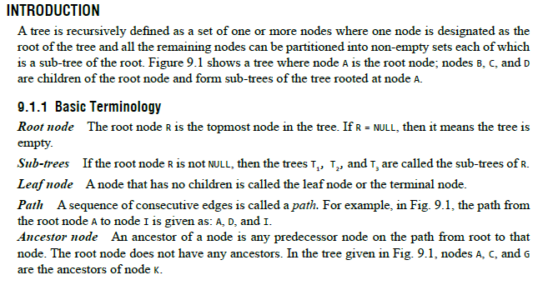
INTRODUCTION

Slide 3
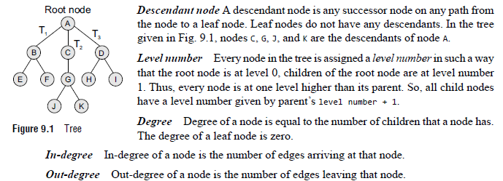

Slide 4
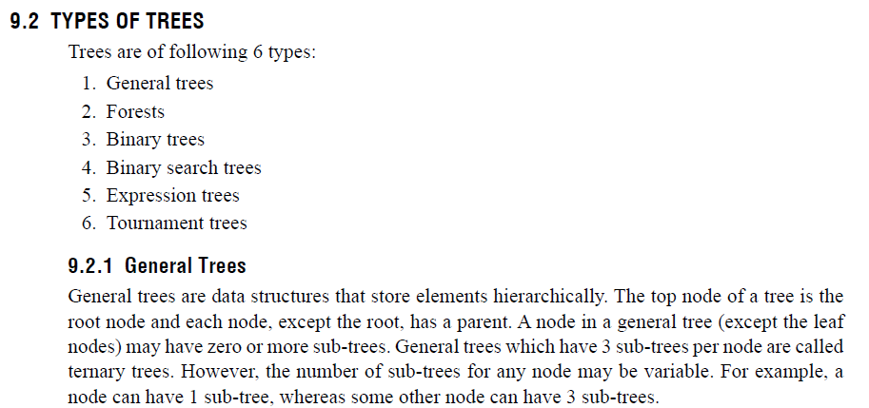
TYPES OF TREES

Slide 5
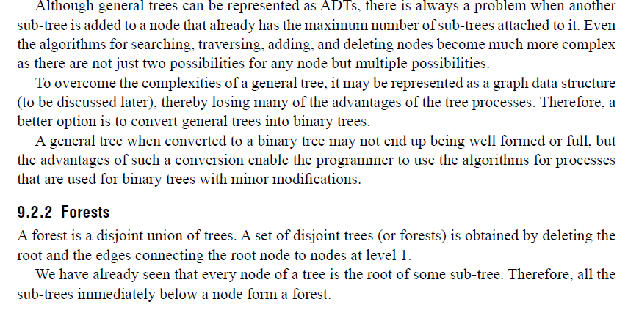

Slide 6
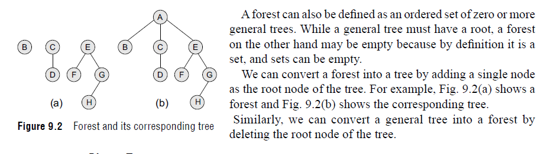

Slide 7
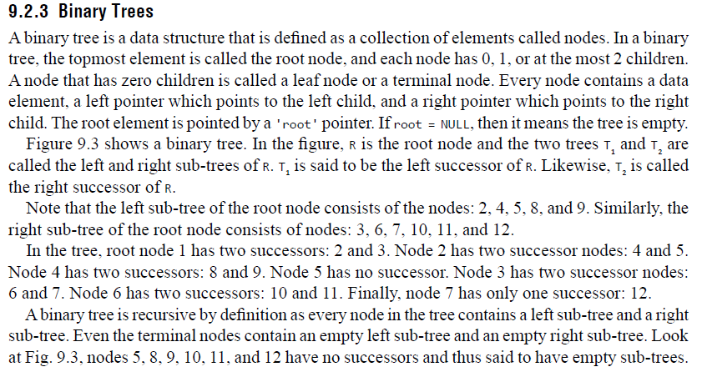
Binary Trees

Slide 8
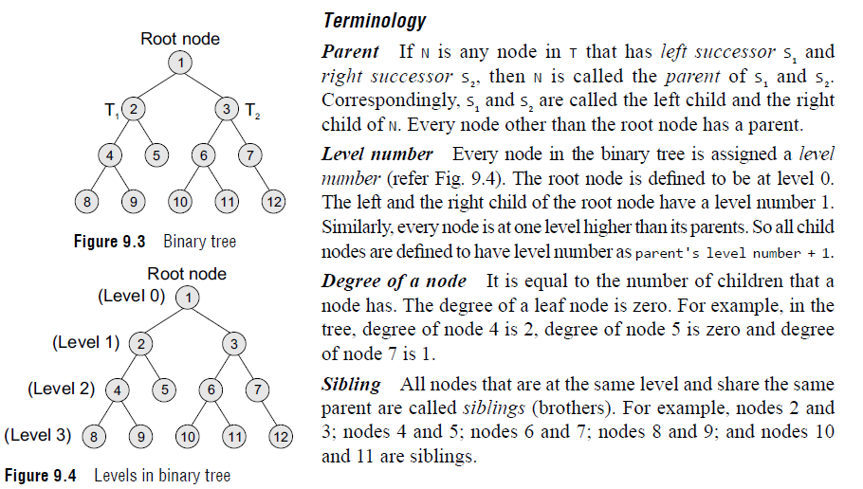

Slide 9
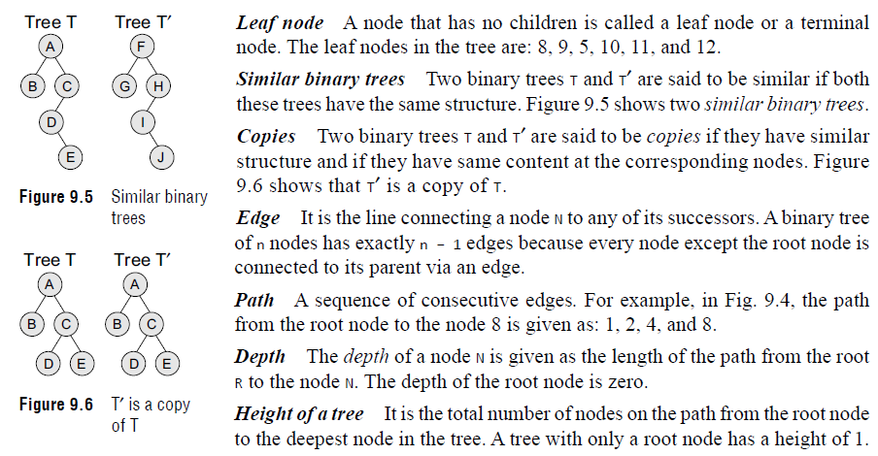

Slide 10
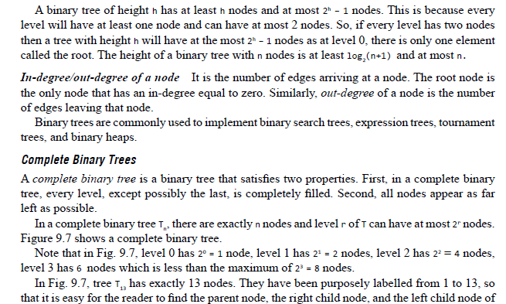

Slide 11
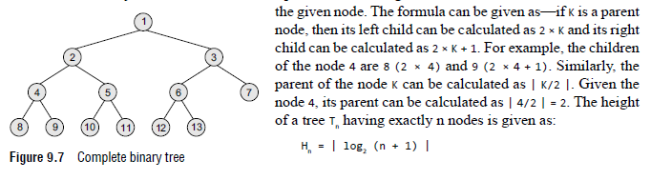

Slide 12
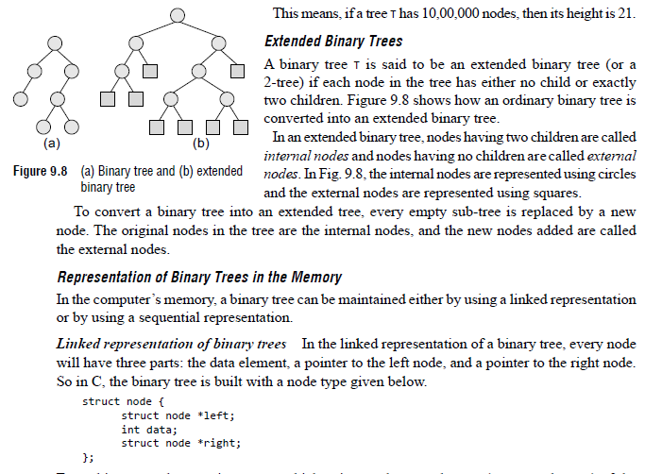
Linked representation of binary trees

Slide 13
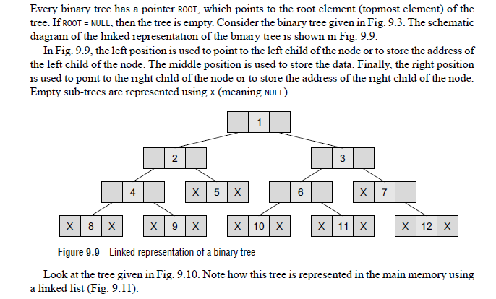

Slide 14
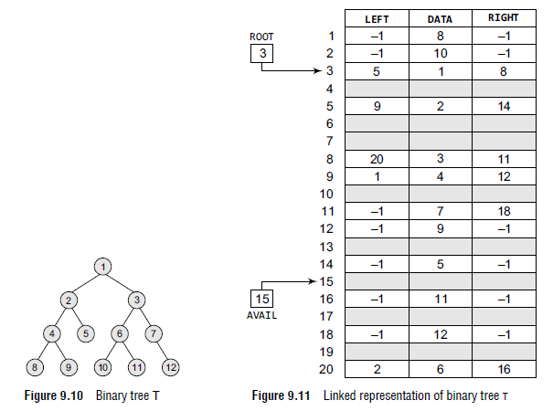

Slide 15
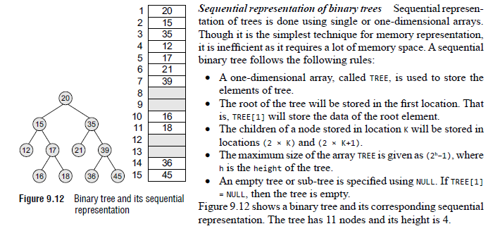
Sequential Representation of Binary Trees

Slide 16
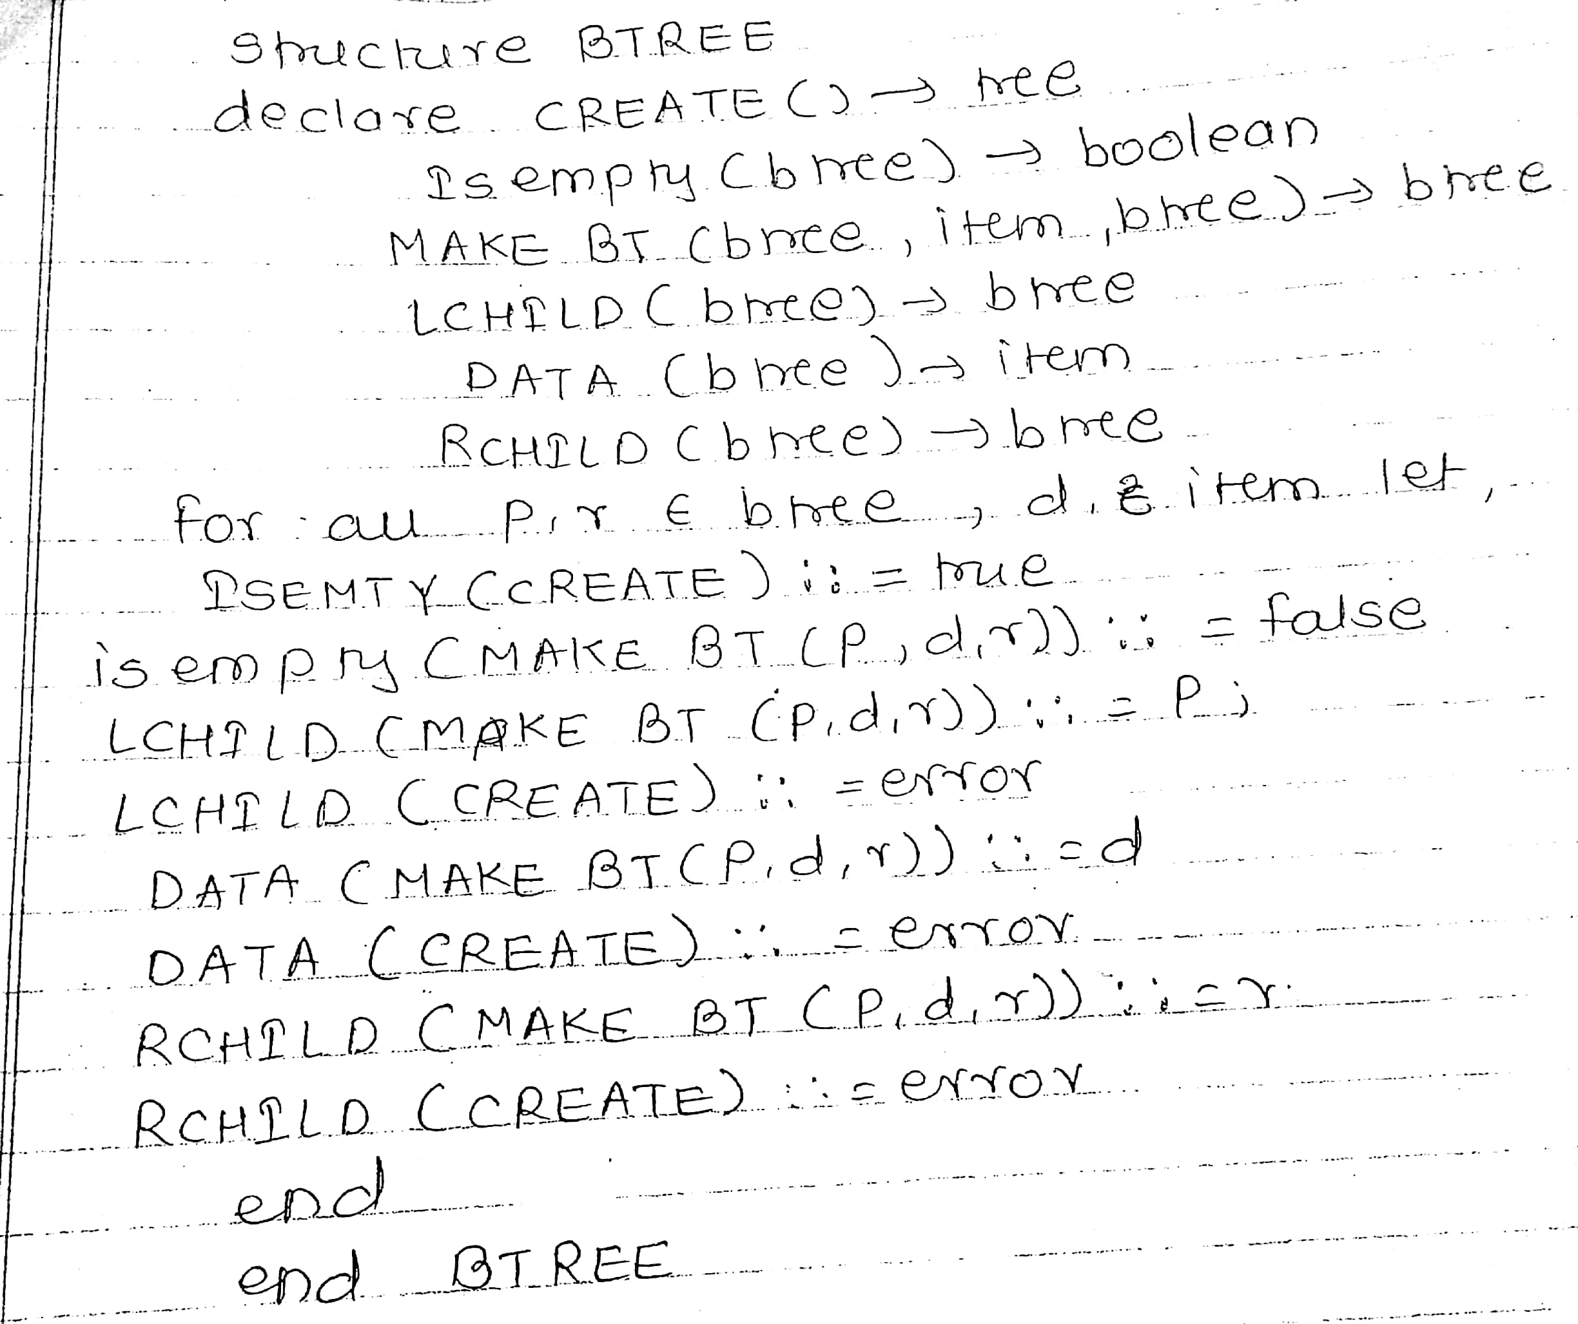

Slide 17
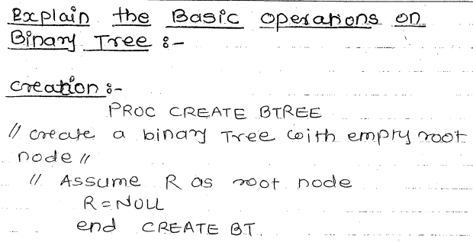

Slide 18
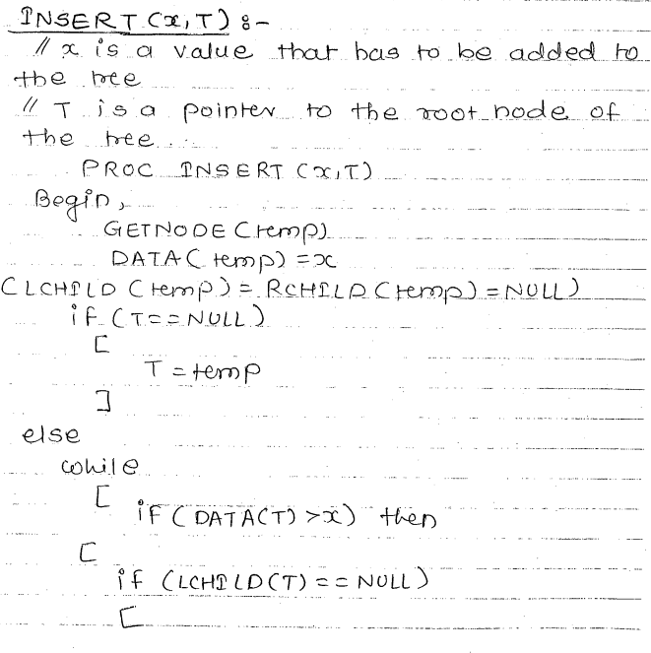
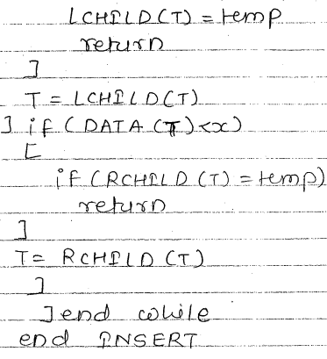

Slide 19
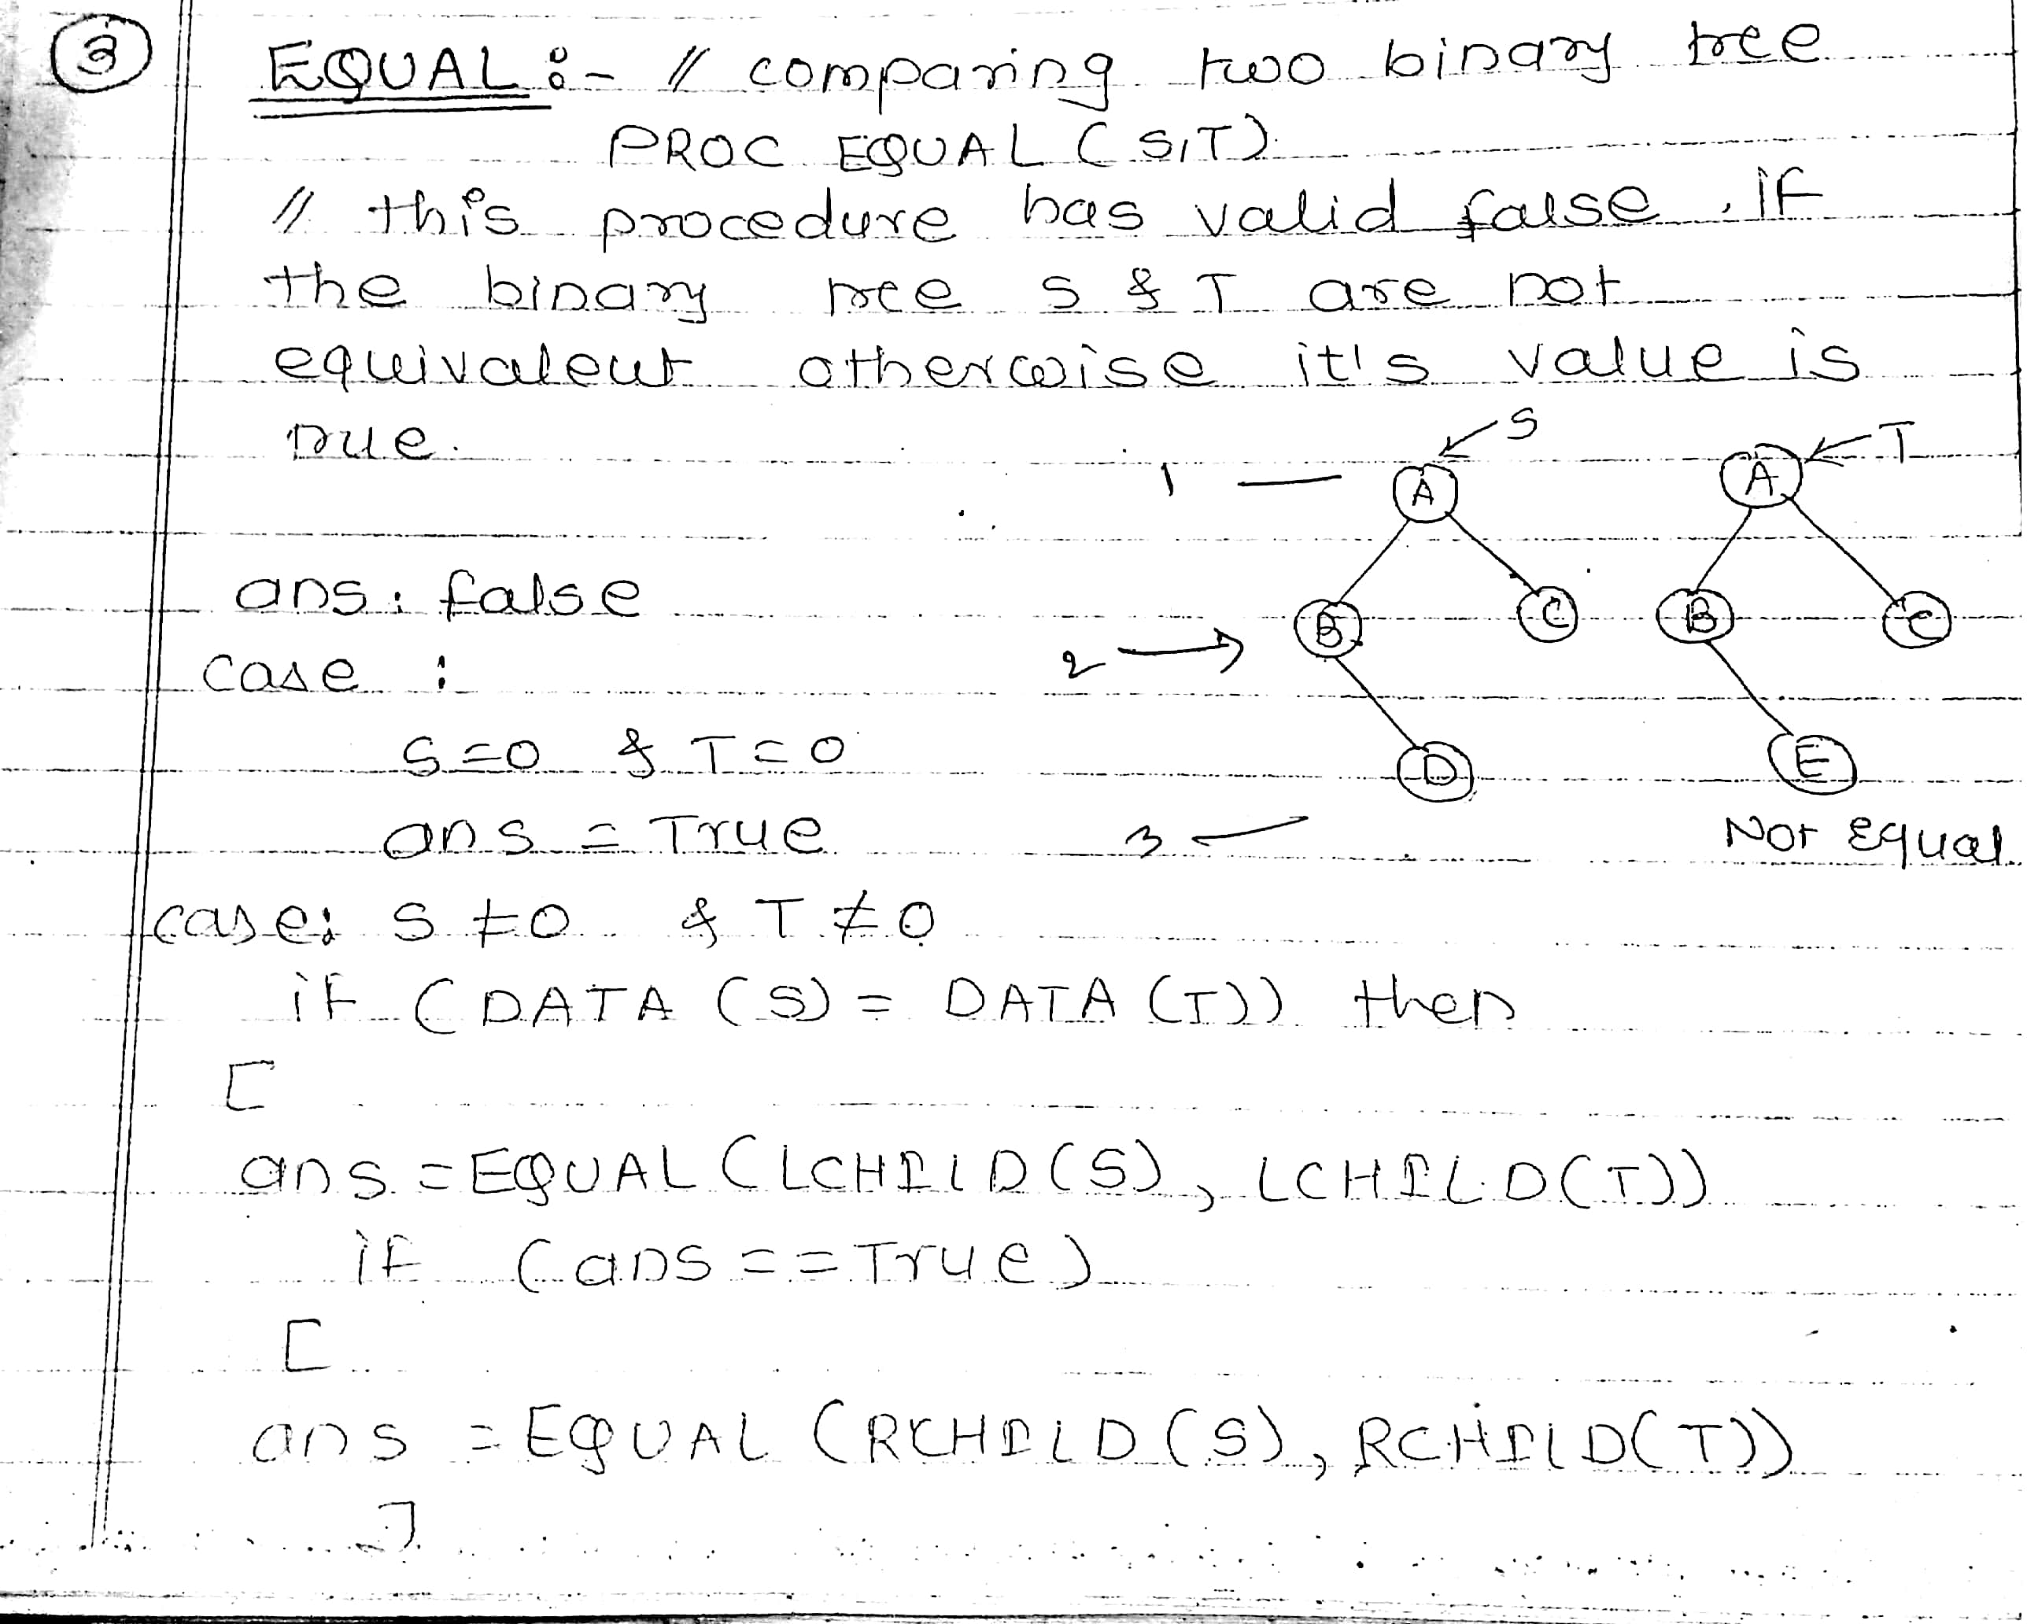
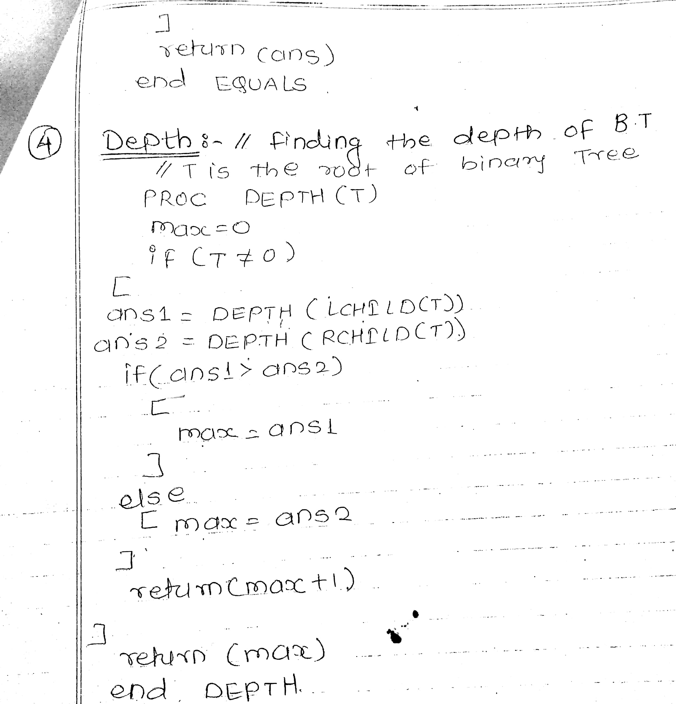

Slide 21
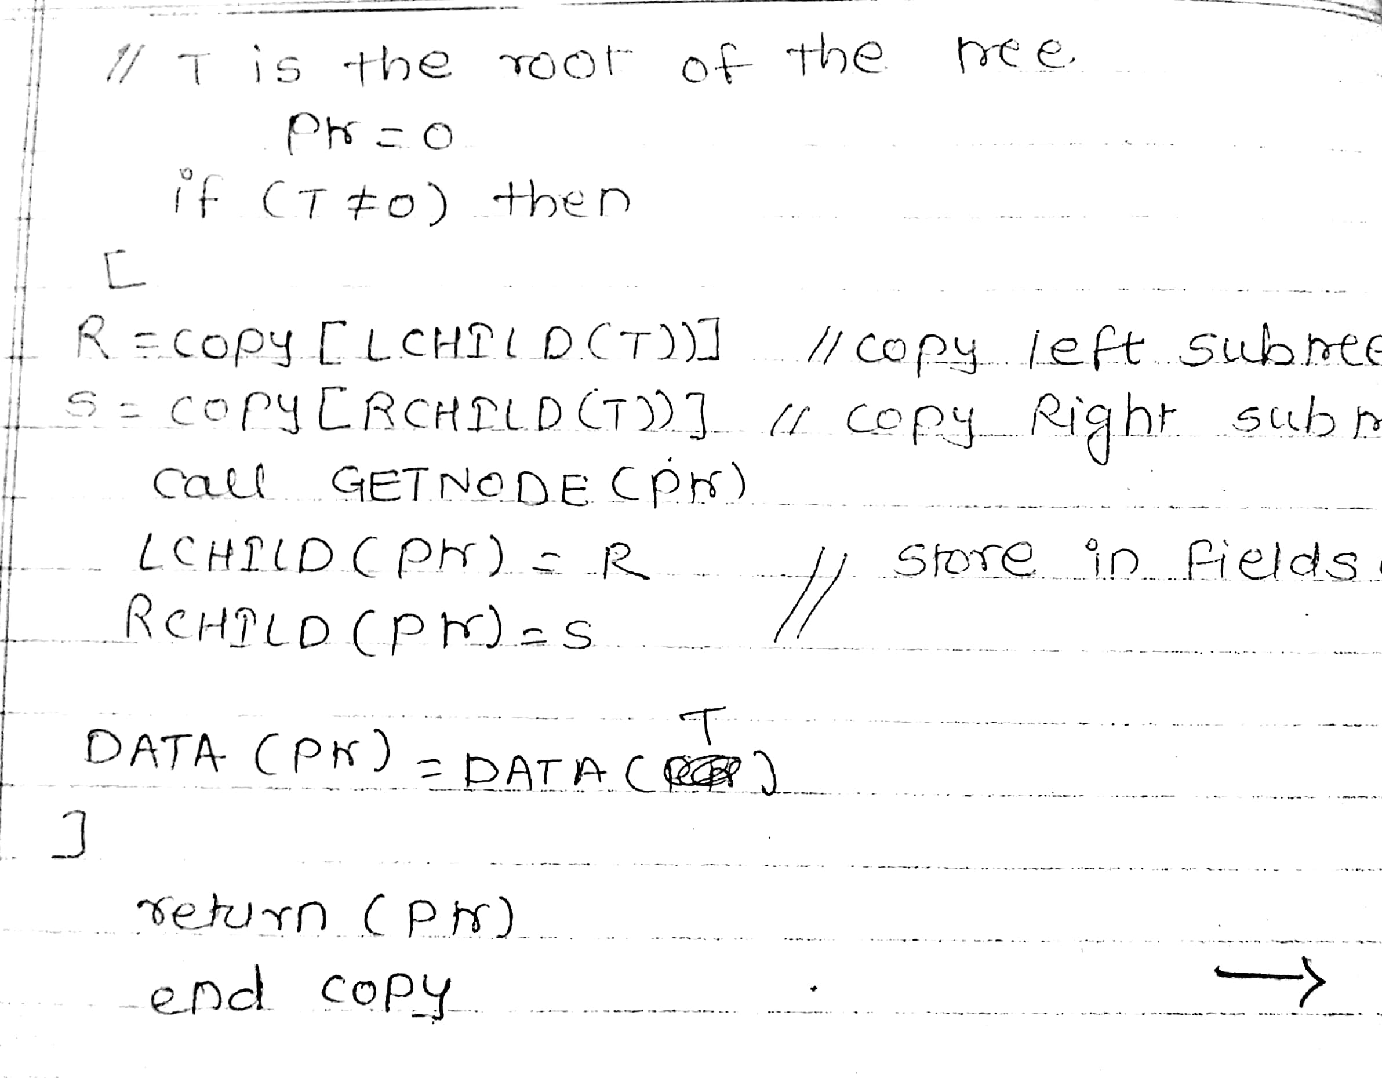

Slide 22
Counting Number of Nodes
Define a function left_height(root) and find the left height of the given Tree by traversing in the root’s left direction and store it in a variable, say leftHeight.
Define a function right_height(root) and find the right height of the given Tree by traversing in the root’s right direction and store it in a variable, say rightHeight.
Find the left and the right height of the given Tree for the current root value and if it is equal then return the value of (2^{height} – 1) as the resultant count of nodes.
Otherwise, recursively call for the function for the left and right sub-trees and return the sum of them + 1 as the resultant count of nodes.

Slide 23
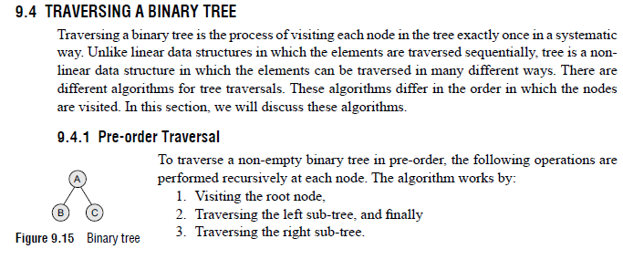
TRAVERSING A BINARY TREE

Slide 24
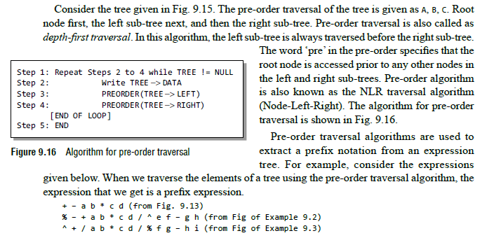

Slide 25
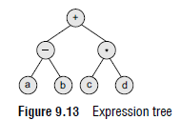
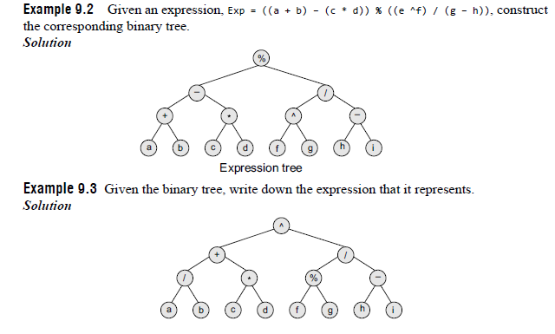

Slide 26
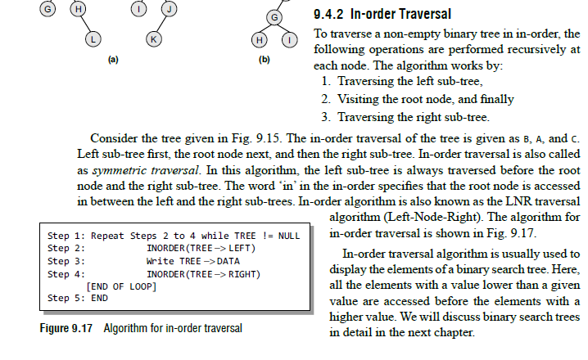

Slide 27
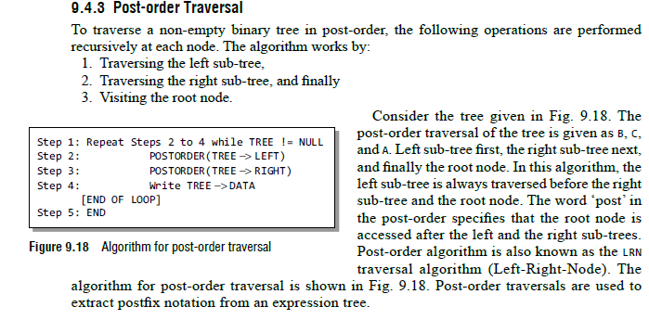

Slide 28
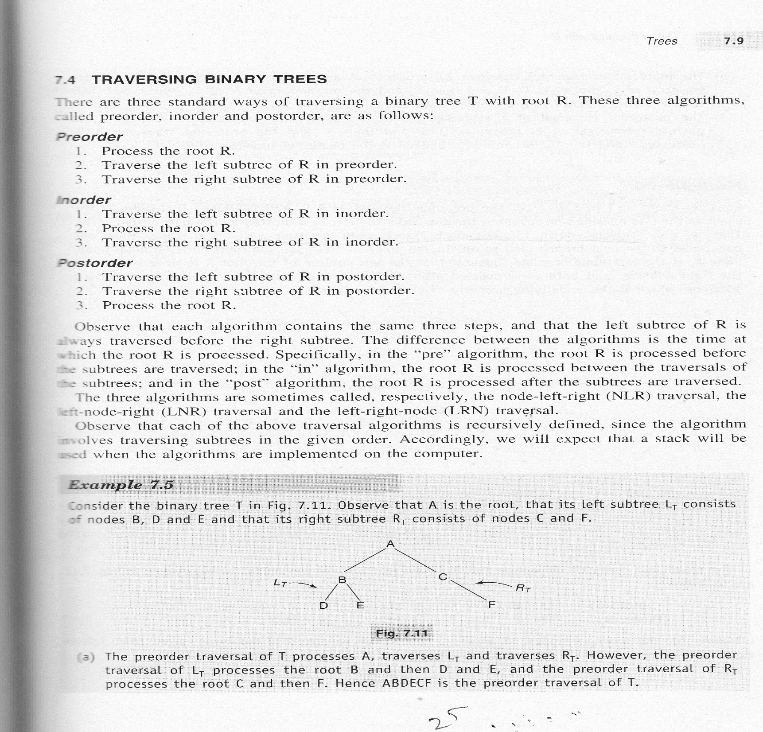

Slide 29
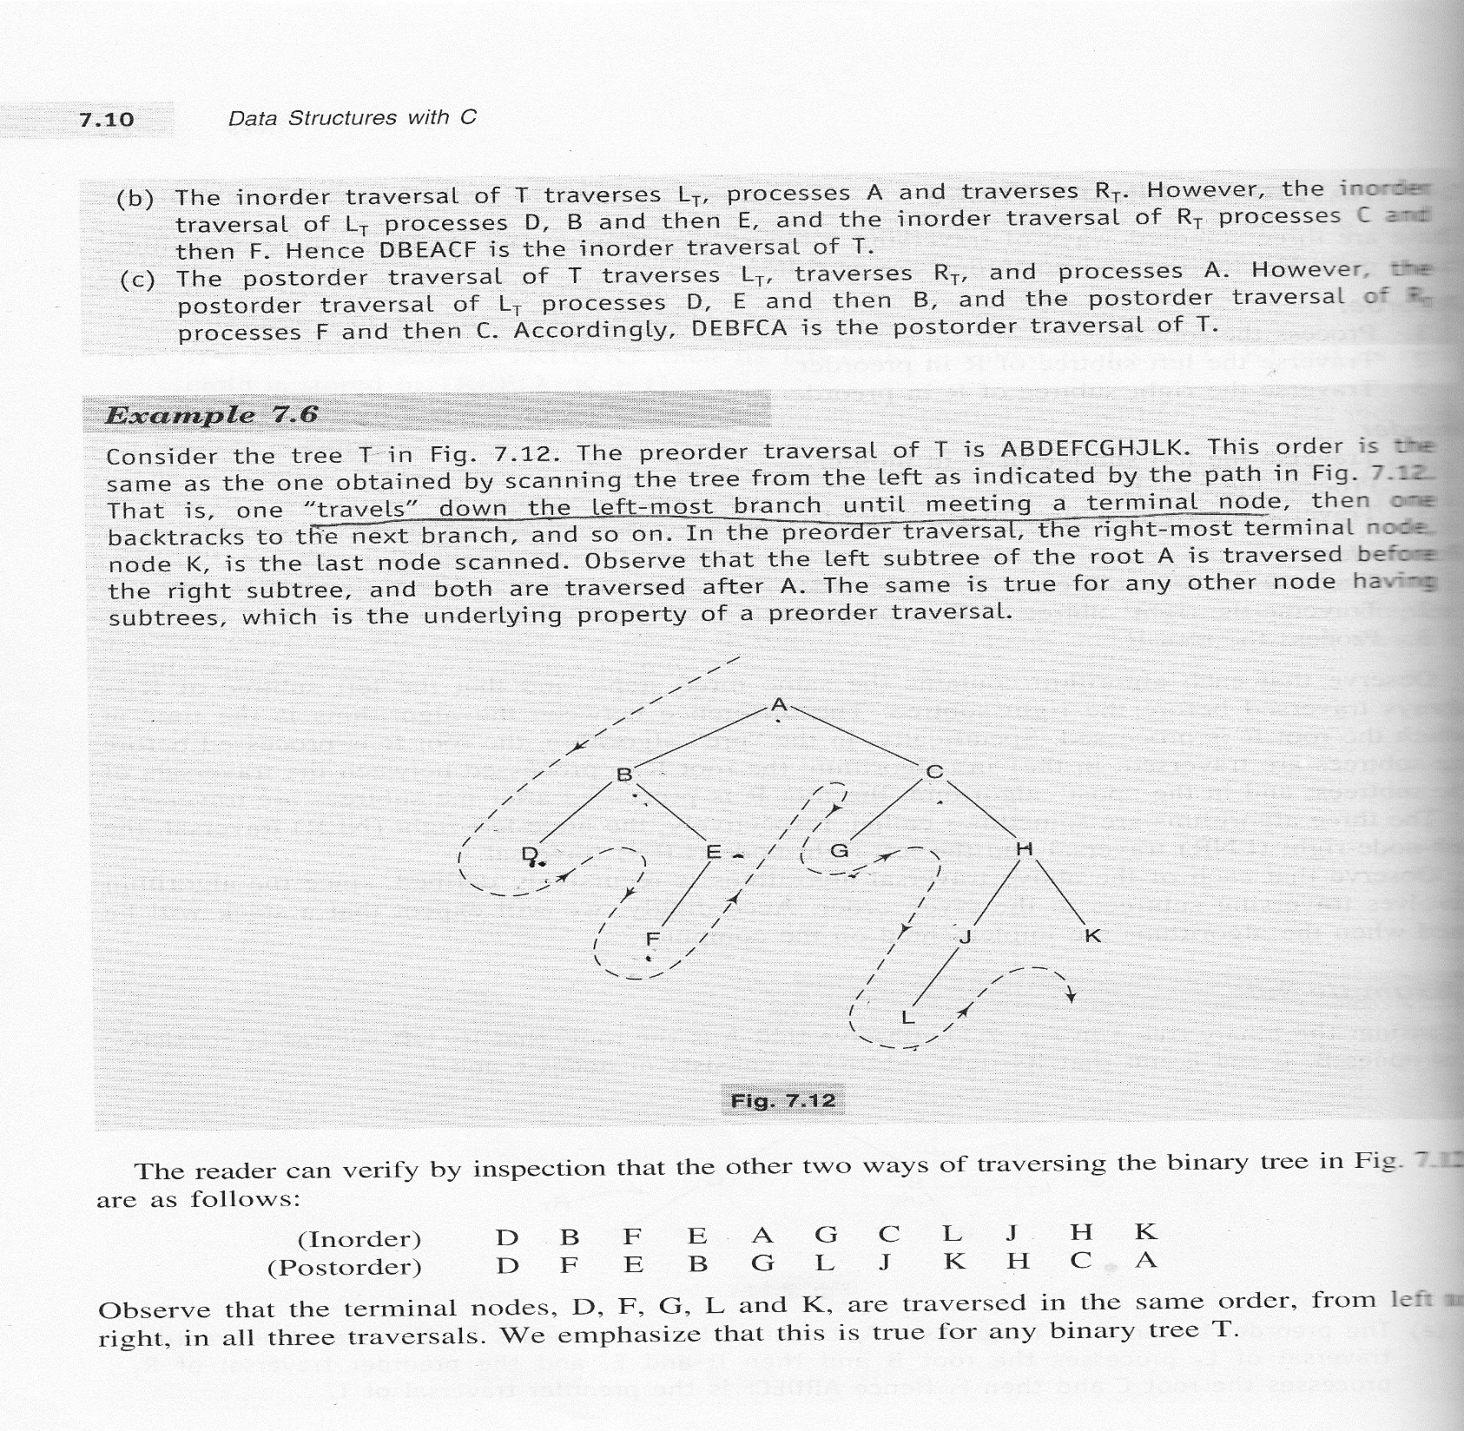

Slide 30
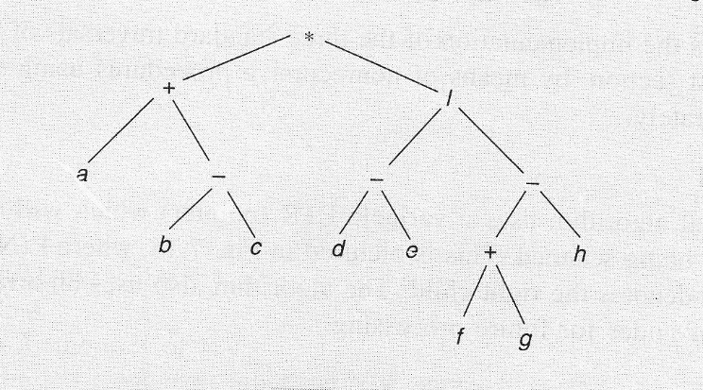

Slide 31
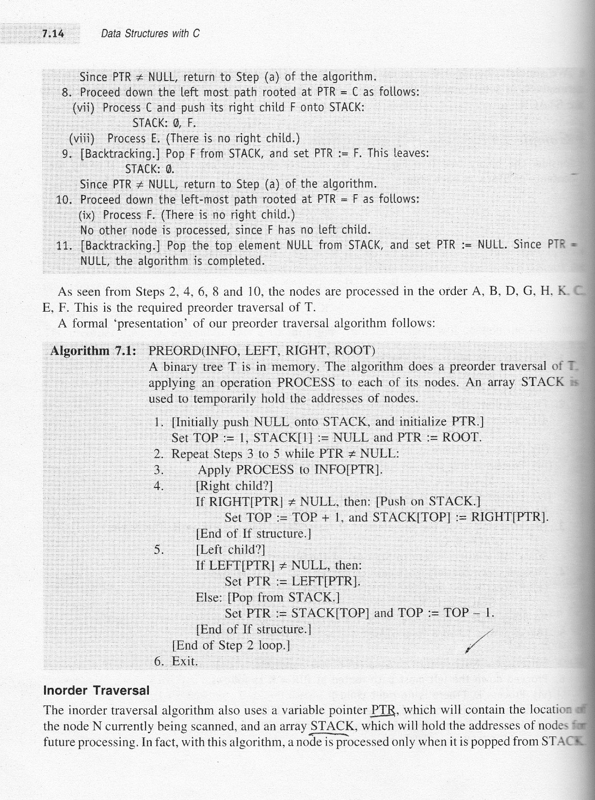

Slide 32
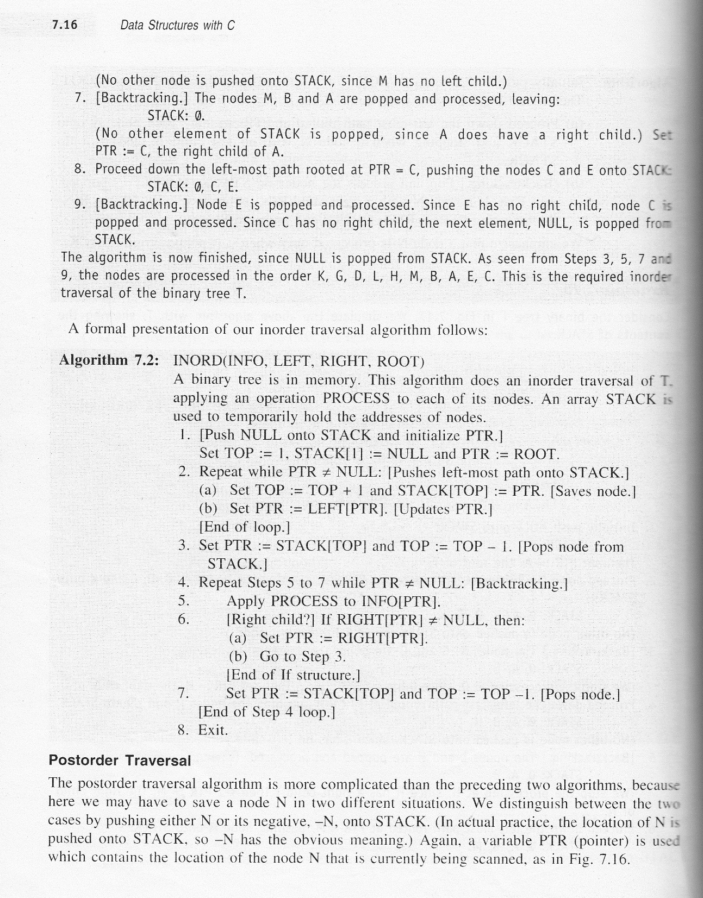

Slide 33
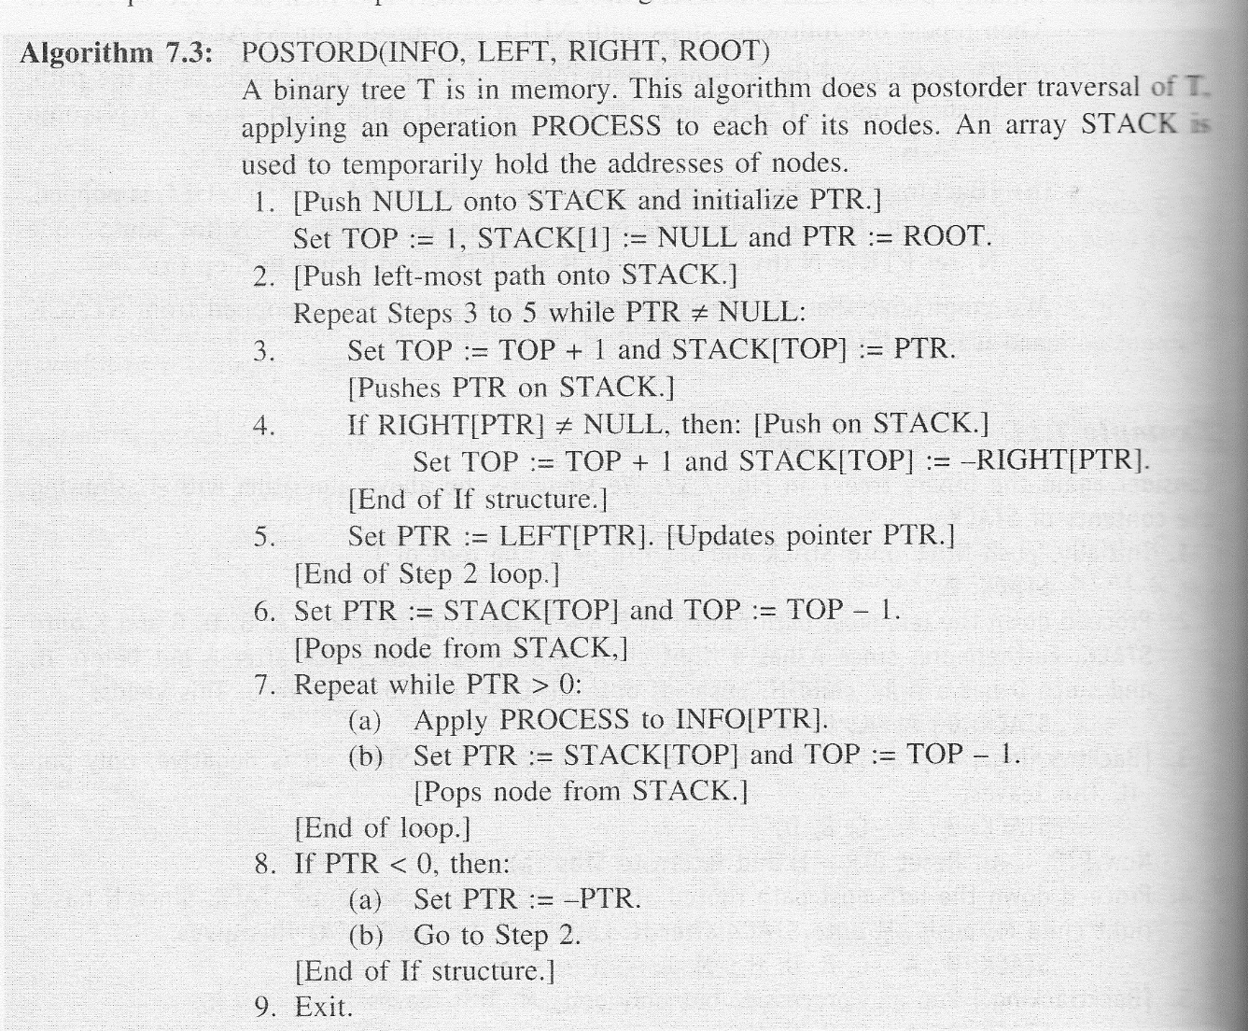

Slide 34
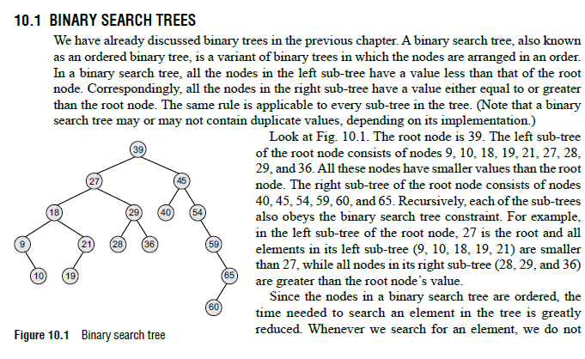
BINARY SEARCH TREES

Slide 35
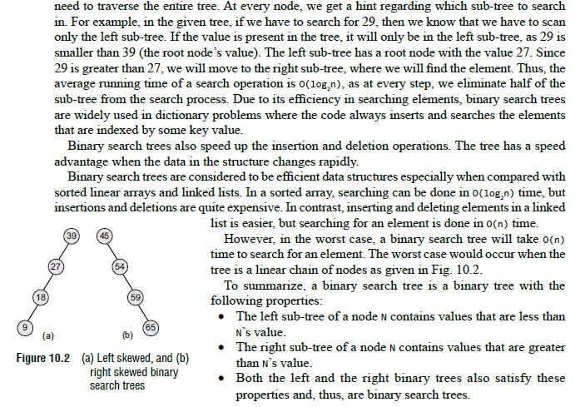

Slide 36
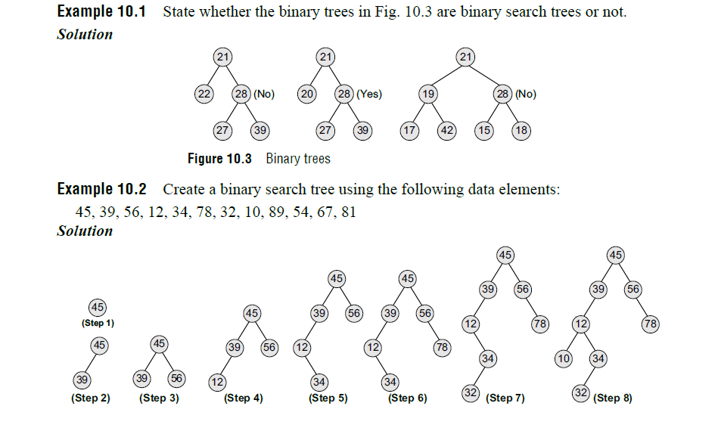

Slide 37
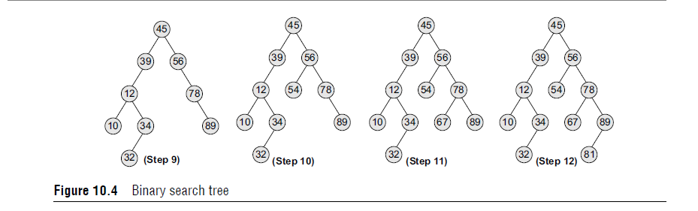

Slide 38
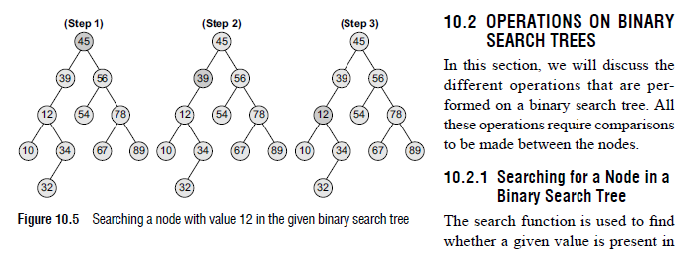
OPERATIONS ON BINARY SEARCH TREES

Slide 39
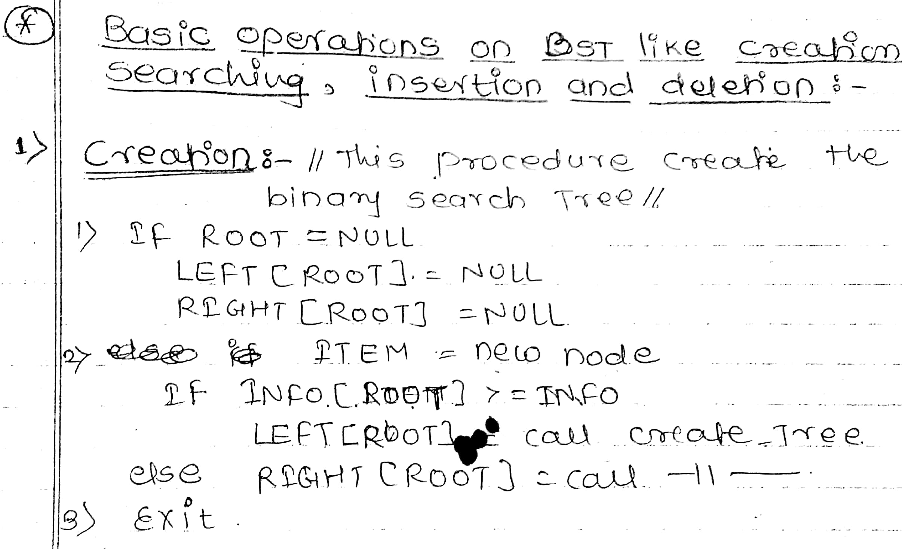

Slide 40
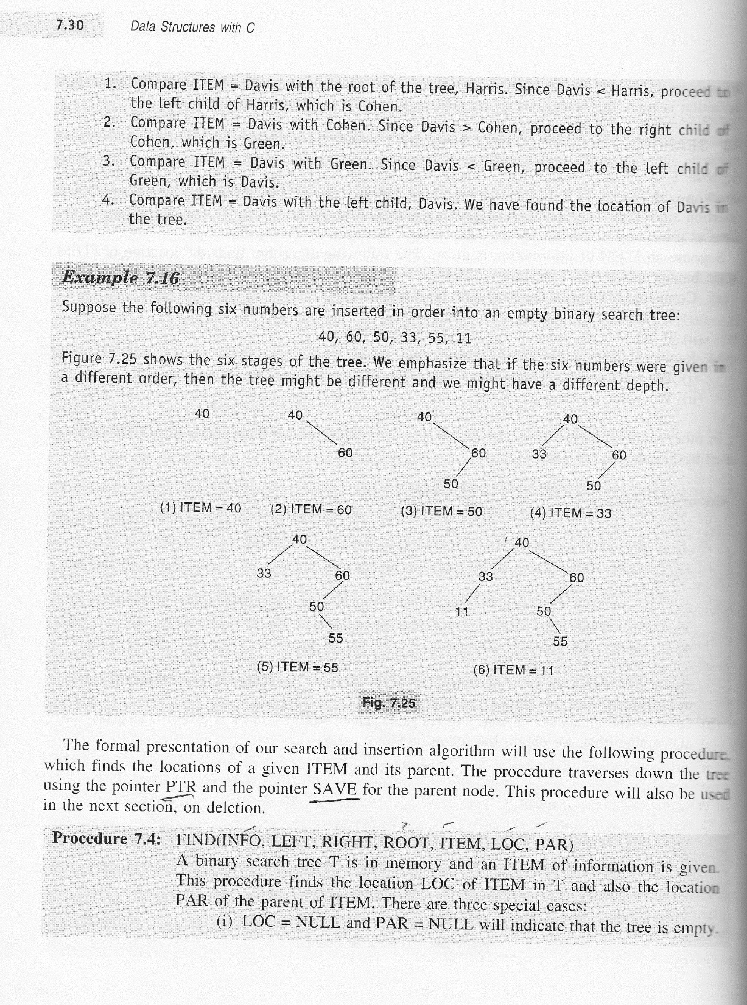

Slide 41
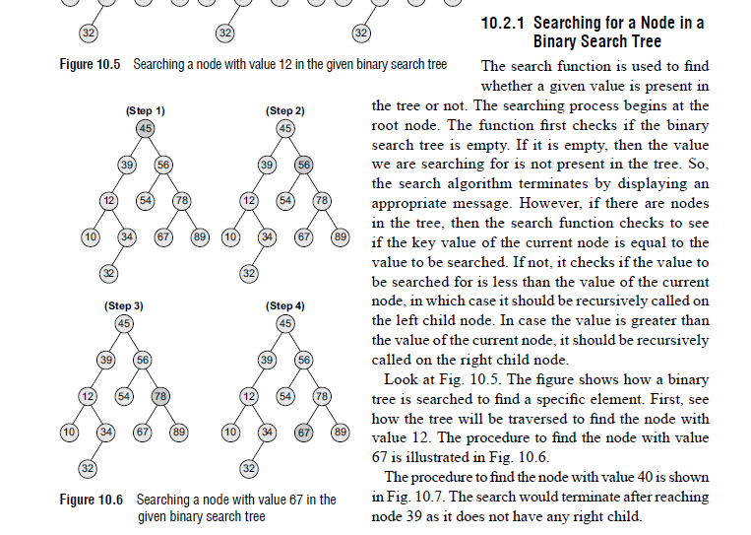

Slide 42
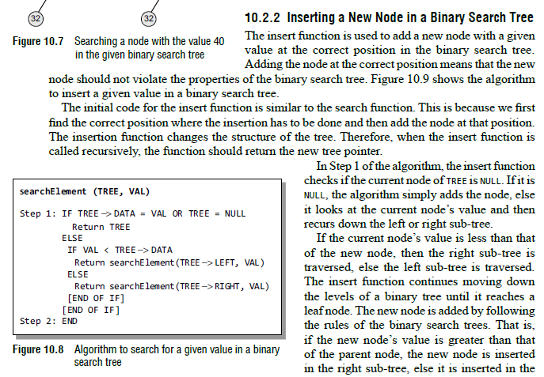
Inserting a New Node in a Binary Search Tree

Slide 43
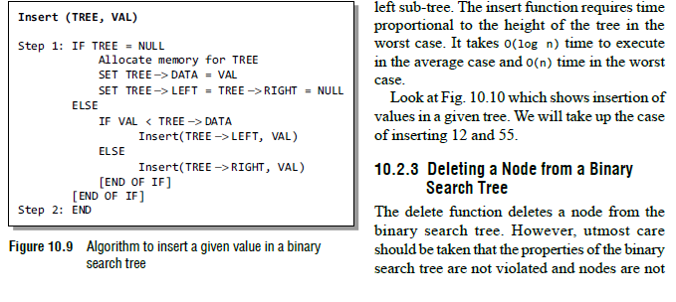

Slide 44
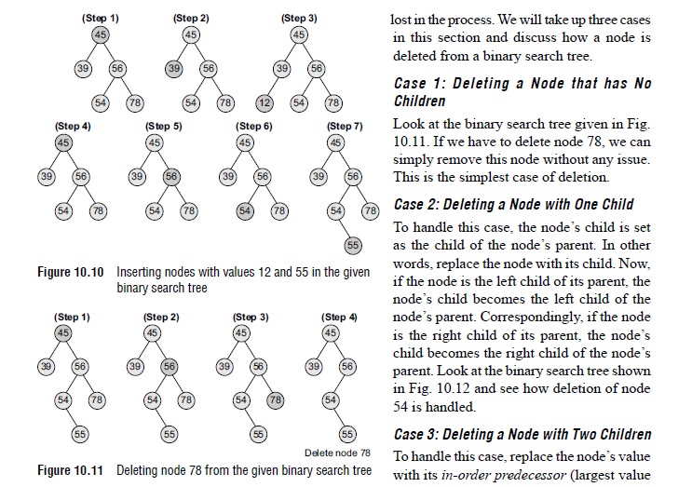
Deleting a Node from a Binary Search Tree

Slide 45
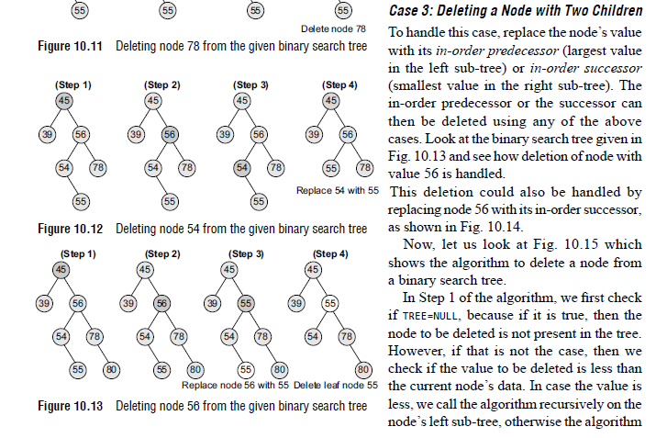

Slide 46
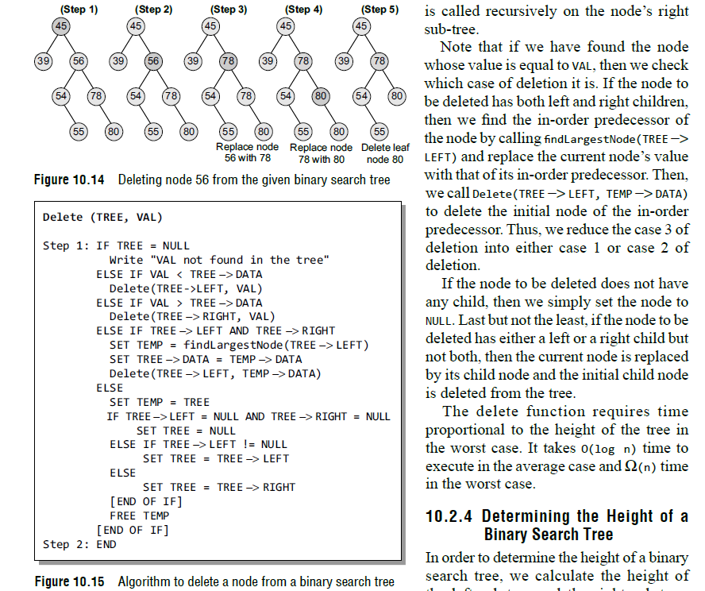

Slide 47
THREADED BINARY TREEs
A threaded binary tree is the same as that of a binary tree but with a difference in storing the NULL pointers. Consider the linked representation of a binary tree as given in Fig. 10.28.

Slide 52
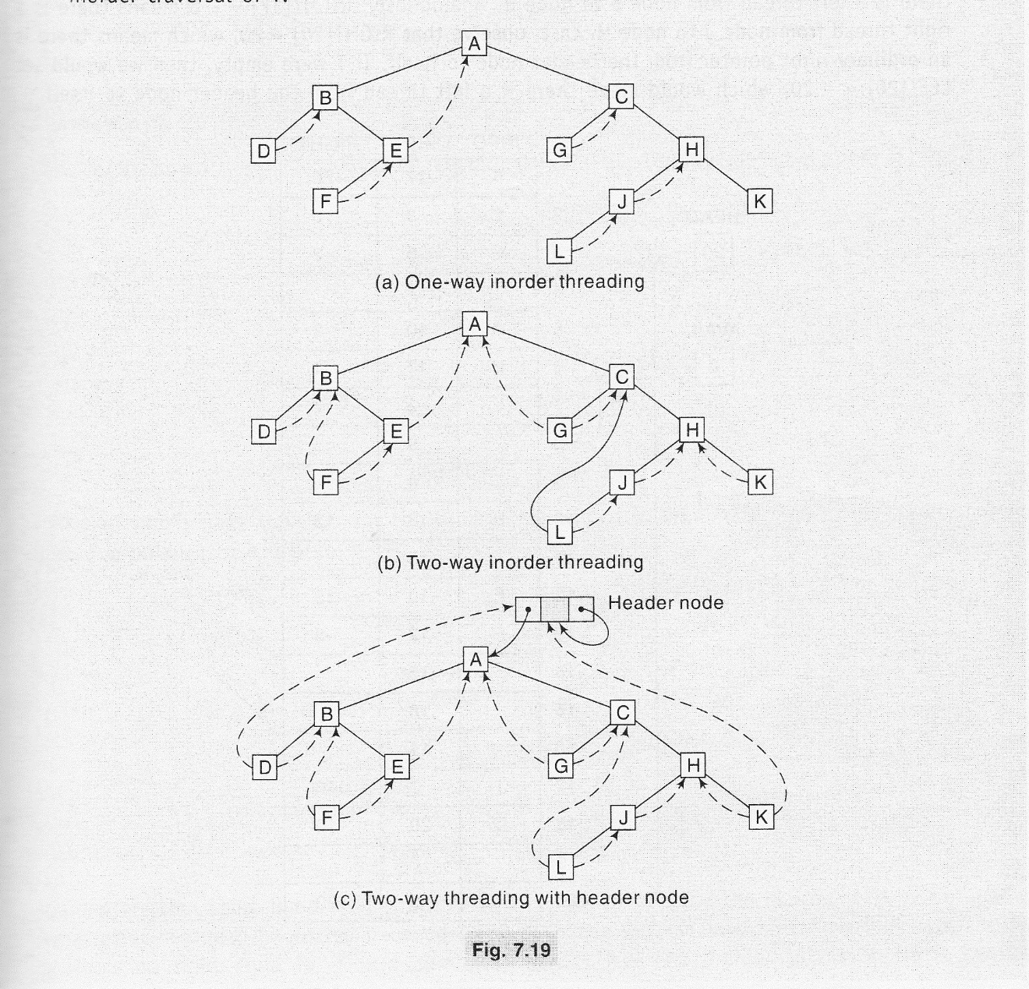

Slide 56
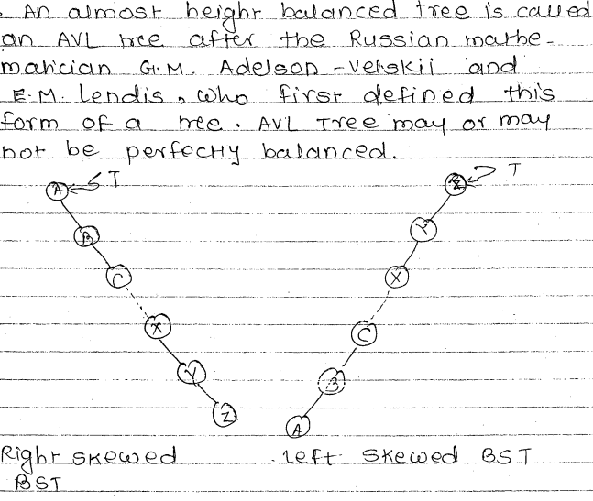
Height Balanced Tree (AVL)

Slide 57
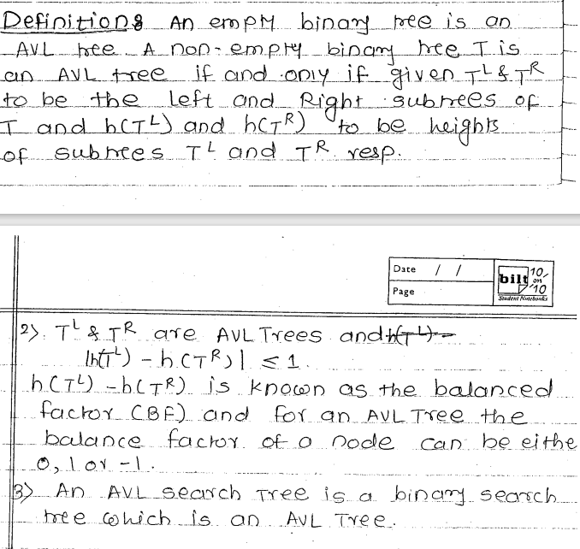

Slide 58
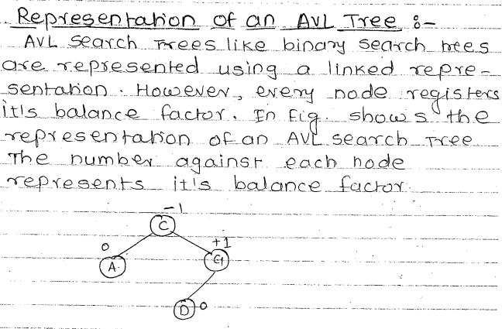

Slide 59

Insertion Into AVL Trees

Slide 60


Slide 61


Slide 62


Slide 63


Slide 64





Slide 65


Slide 66


Slide 67


Slide 68


Slide 69


Slide 70


Slide 71


Slide 72


Slide 73


Slide 74


Slide 75


Slide 76


Slide 77


Slide 78


Slide 79


Slide 80


Slide 81


Slide 82


Slide 83


Slide 84


Slide 85


Slide 86


Slide 87


Slide 88


